Slide 1
Biblical Conflict Resolution
Rev. Dr. Tony W. Barr Sr.
Notes:
Biblical

Slide 2
Genesis 32:1-6 NKJV

Slide 3
Genesis 32:1-6 (NKJV)
¹ So Jacob went on his way, and the angels of God
met him.
² When Jacob saw them, he said, “This is
God’s camp.” And he called the name of that place
Mahanaim.
³ Then Jacob sent messengers before him to Esau his brother in the land of Seir, the country of Edom.

Slide 4
Genesis 32:1-6 (NKJV)
⁴ And he commanded them, saying, “Speak thus to
my lord Esau, ‘Thus your servant Jacob says: “I have
dwelt with Laban and stayed there until now.
⁵ I have oxen, donkeys, flocks, and male and female
servants; and I have sent to tell my lord, that I may find
favor in your sight.”
⁶ Then the messengers returned to Jacob, saying,
“We came to your brother Esau, and he also is
coming to meet you, and four hundred men are with him.

Slide 5
Genesis 33:1-8 NKJV

Slide 6
Genesis 33:1-8 (NKJV)
¹ Now Jacob lifted his eyes and looked, and there,
Esau was coming, and with him were four hundred
men. So he divided the children among Leah, Rachel,
and the two maidservants.
² And he put the maidservants and their children in
front, Leah and her children behind, and Rachel and
Joseph last.
³ Then he crossed over before them
and bowed himself to the ground seven times, until he came near to his brother.

Slide 7
Genesis 33:1-8 (NKJV)
⁴ But Esau ran to meet him, and embraced him, and
fell on his neck and kissed him, and they wept.
⁵ And he lifted his eyes and saw the women and
children, and said, “Who are these with you?” So he
said, “The children whom God has graciously given
your servant.”
⁶ Then the maidservants came near, they and their
children, and bowed down.

Slide 8
Genesis 33:1-8 (NKJV)
⁷ And Leah also came near with her children, and they bowed down. Afterward Joseph and Rachel came
near, and they bowed down.
⁸ Then Esau said, “What do you mean by all this
company which I met?” And he said, “These are to
find favor in the sight of my lord.”

Slide 9
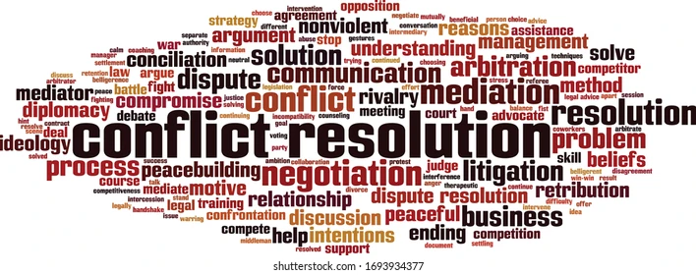
Biblical Conflict Resolution

Slide 10
Definition of Conflict
a struggle for power, property, etc.; strong disagreement between people, groups, etc., that results in often angry argument.
A difference that prevents agreement: disagreement between ideas, feelings, etc.
(Merriam Webster)

Slide 11
Conflict exists wherever people’s needs are met (family, work, church, fraternity/sorority, restaurant, grocery store, etc.)

Slide 12
Source of Conflict
Sin can be the source of conflict or a byproduct of unresolved conflict.
Living in unforgiveness seats you in opposition to Jesus’ love

Slide 13
Major Challenge to Conflict Resolution
One of the greatest challenges to
conflict resolution is that it attempts to change/re-account the unchangeable past.
Conflict of an unchangeable past Vs. present reality

Slide 14
Biblical Illustration of the Need for Conflict Resolution
-Born in conflict
-Lived in conflict
-Maternal conflict
-Contradictory Conflict
-Deflection or Blame Conflict
-God was the source of the conflict

Slide 15
Encounter of Jacob & Esau
Overview
Separation (20 years)
Self-exile
Struggles of life
God initiated the encounter

Slide 16
Biblical Conflict Resolution
Conflict resolution begins and ends with God
¹ So Jacob went on his way, and the angels of God met him. ² When Jacob saw them, he said, “This
is God’s camp.” And he called the name of that
place Mahanaim.
Genesis 32:1-6

Slide 17
Conflict includes
-Personal perspective (what I deserve or want)
-Justification (why it was done)
-Reasoning (why it makes sense)
-Frustration over insufficient recompense or
remorse
-Penalization (punishment)
-Suffering & loss (kingdom of God)

Slide 18
Believer’s immediate
response to conflict:
Where Is God In This?

Slide 19
Conflict Resolution: Two Sides of the same Coin (Gen 32:3-6)
Jacob
Sacrifice to show up
Fear & uncertainty
Version of the story
Tested the water
Created wall of protection
Matured & changed
Esau
Sacrifice to show up
Fear & uncertainty
Version of the story
Responded to inquiry
Entourage of servants*
Matured & changed
Your side of the coin only represents ½ of the story (incomplete)

Slide 20
Principles of
Conflict
Resolution

Slide 21
Principles of Conflict Resolution
(Gen 33:1-6)
You Must Seek It Vs.1 “Jacob lifted his eyes and looked”
Hold captive thoughts of scenarios Vs.1 “Esau with 400 men”
Be willing to sacrifice something “divided the children…two maidservants”
Bind up the “strongman” (person) Vs.3-4 (no room for pride/ego)
Ask questions, listen attentively, and avoid judgement Vs.8

Slide 22
The Purging Conflict (Areas That Need To Be Addressed)
Feeling __________________________________________________
Emotions ________________________________________________
Ego _____________________________________________________
Pain ____________________________________________________
Loss ____________________________________________________
Payback! ________________________________________________
*Own the part you played in the conflict!

